Slide 1
Wheelchair Interview
Chuck Martin, Shawn Timothy, Tena Fitzgerald
PTA 2100 - Signature Assignment

Slide 2
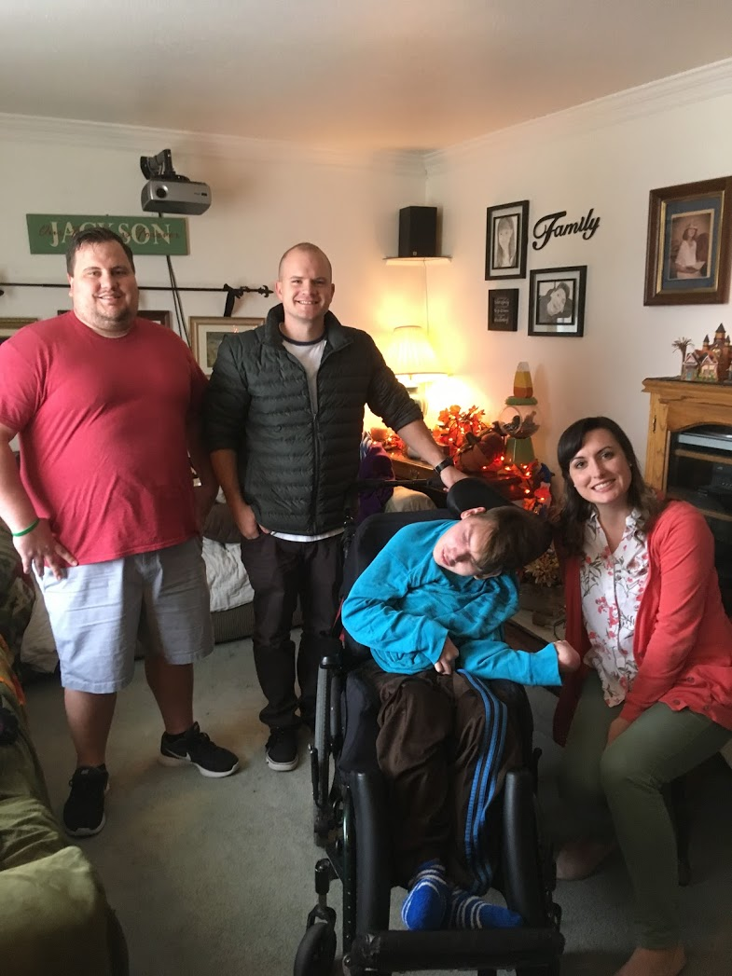
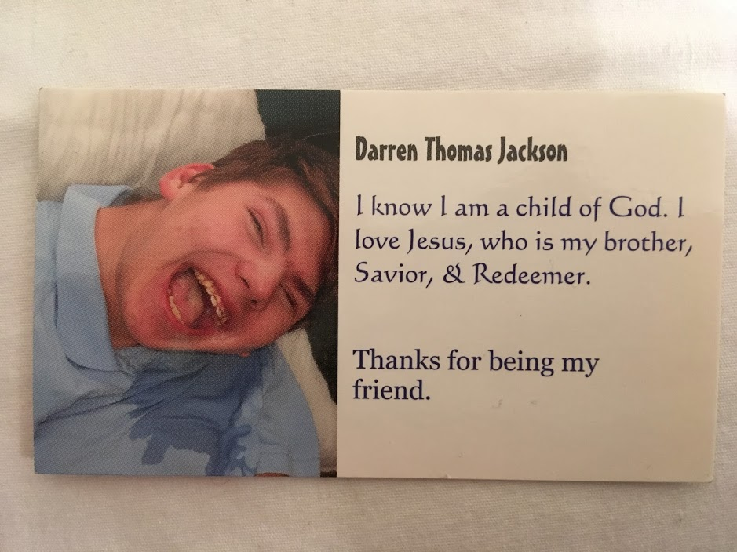
Darren Jackson
Notes:
Interviewed Darren’s mom, Cindy.
Darren has Spastic Quadriplegia Cerebral Palsy. He has lost the use of his whole body and has maximal limitations. He requires the assistance of caregivers for all his needs. He has severe scoliosis and muscle contractures that have lead to limb deformities. He is 21 years old this december.

Slide 3
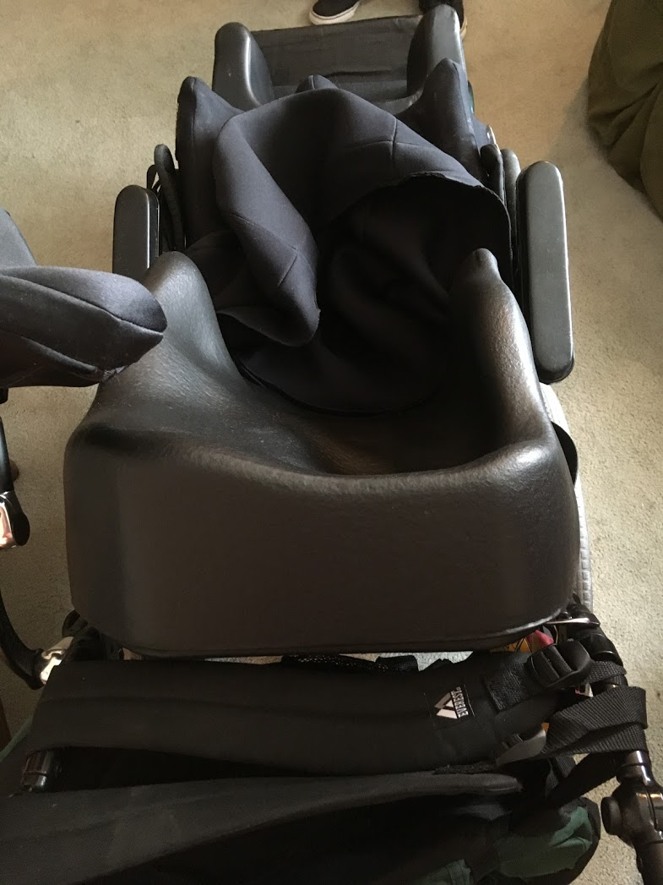
Question #1
How do you properly fit a wheelchair for function, comfort, stability, safety, and protection of body structures? Who suggests the adjustments needed
What adaptations have been made to make the chair more comfortable as he grows (Parts, adjustments)
Notes:
Darren is fit for wheelchair by PT’s and OT’s at his school - hartvigsen school (Lisa Stone)
As he grows he has molds formed to contours of his body every 7 years.
Has molds for his back, hips, and legs.
Tilts to allow pressure relief and comfort
Now that he is not really growing the time between fittings may not be as often.
Darren attends Hartvigsen, where he gets most of his adjustments for his wheelchair to provide a proper fit and they provide him with the most comfort available. Legs have a mold as well, there is a platform across. No straps because he can not move.
Because of the curvature of his spine he can not sit in a regular chair, they have a material that is much like memory foam, that they are able to sit him in and mold a cushion that is custom fit for all of the contours of his body.
Head rest is arranged to the side to accommodate, some attachments that can keep head up (not the most comfortable

Slide 4
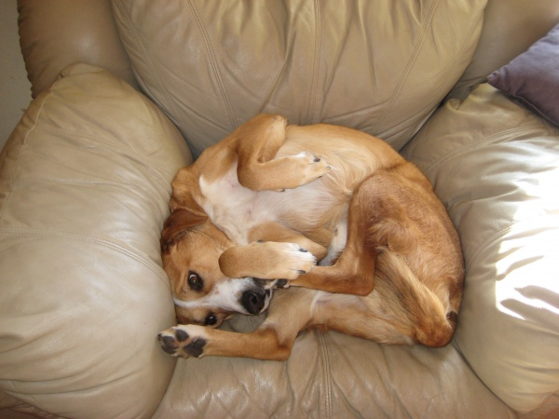
Question #2
Does Darren ever get uncomfortable in his chair? (edema, sores, etc.)
What signals does he give to show discomfort?
What measures are taken to improve comfort level?
Notes:
Yes, getting used to a new seat. Not breathable and Darren has poor heat management causing heat exhaustion. Hasn’t had any sores, swelling from his chair.
Crying; “the look”
Tilt the seat; cold rags; remove from chair (usually isn’t in the chair for more than 3 hours at a time)

Slide 5
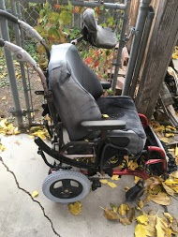
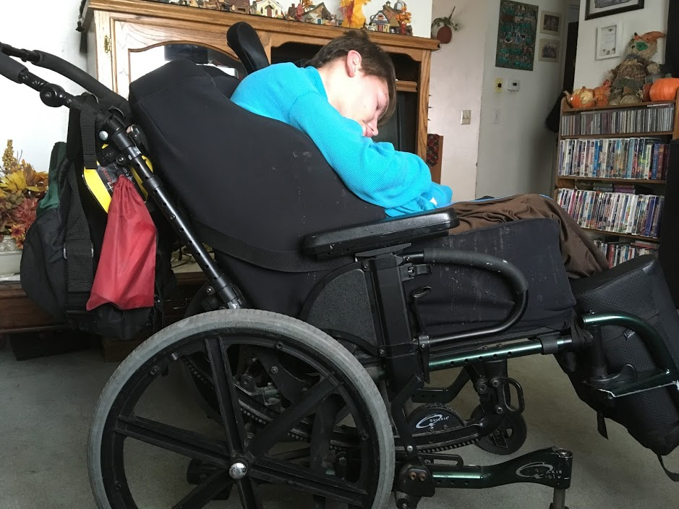
Question #3
Has Darren always had the wheelchair he currently uses?
How long does it take him to become accustom to a new wheelchair?
Notes:
He is on his 4th wheelchair. They change them out every 6-7 years.
Typically a few weeks, but current wheelchair it took him almost three months. The fitting was off and they had to get it refitted.

Slide 6
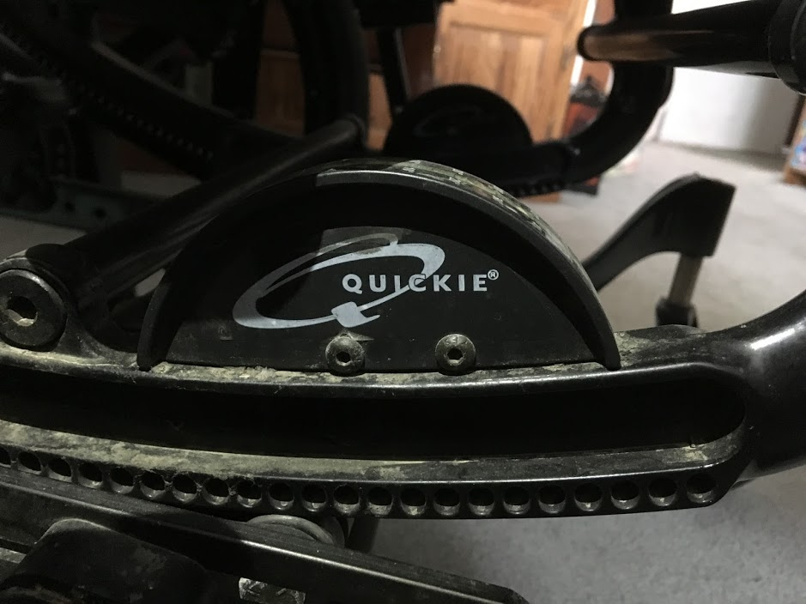
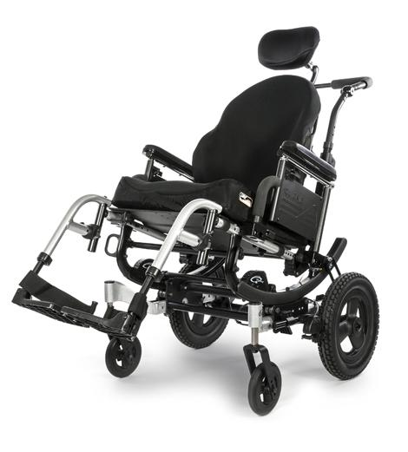
Type of Chair, Insurance
Quickie, IRIS manual tilt wheel chair.
Multiple attachments and molded cushioning.
Tilts at different angles, extended push handles.
Head rest off to side.
Insurance that patient has covers all of the chair.
Notes:
Chair Starts out at ~ $7,000 would be the cost without insurance
For the molded cushion cost would be about $2,000
Total for a chair like theirs would be over $9,000
Medicaid. (IHC will also come out to service the chair)
Disadvantage of the chair is that it is long, especially when tilted. A prior chair darren had when he was younger was not as long, but now that he is full grown it makes it harder to maneuver.

Slide 7
Prerequisite
Skills
Care provider must be able to push a wheelchair up the ramp
Must be cognitive of the ramp width and turn
Must be able to push/lift the chair over door jam
Must be able to navigate wheelchair through door and around static obstacles (piano, couch, etc.)
For getting Darren off the bus

Slide 8
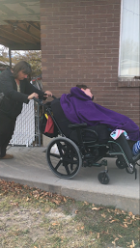
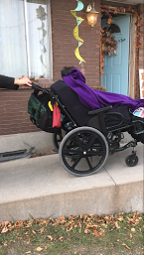
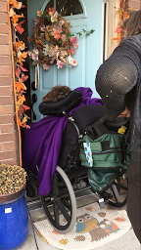
Step by Step
Make sure the walkway is clear and free of obstacles.
Make sure the dog is put in the backyard.
Have the front door open.
Push Darren up the ramp, making sure the chair is in the center of the ramp.
Correctly angle the wheelchair through the door.

Slide 9
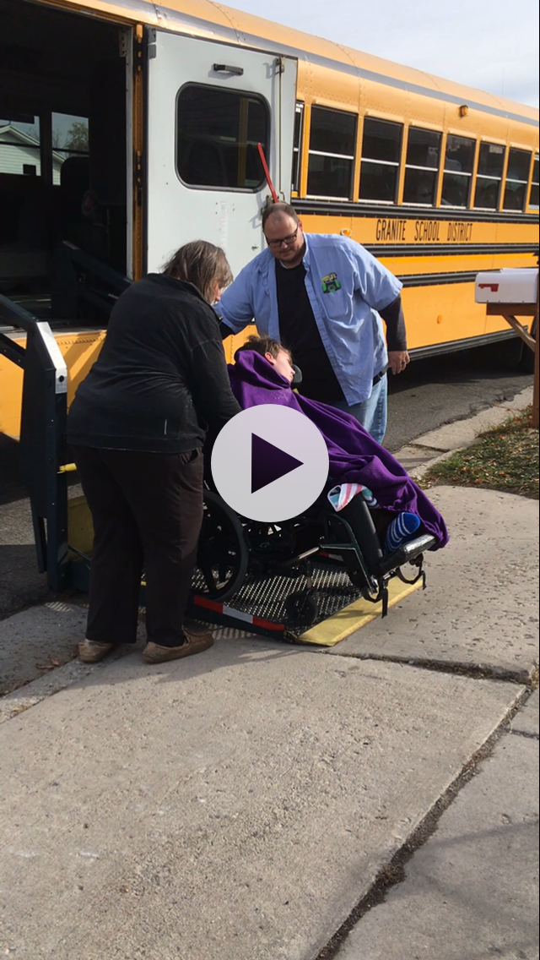
Functional Activity
We asked Cindy to perform a functional activity with Darren.
She showed us how he gets off the bus, goes up the ramp and through a hinged door.

Slide 10
Safety Precautions
The material his wheelchair is made of is not very breathable. He sweats a lot during the summer.
Darren does not move much, so there is not too much of a worry of him getting blisters or raw skin.
At school and home, he is moved enough and does not send long periods of time in his chair to prevent pressure sores.
Make sure you push him down the center of the walkway.
During the winter, they have to make sure the walkway is shovelled and free of ice.
Being aware of how Darren offsets the wheelchair from him leaning.
Notes:
Sometimes Cindy has to wake up early to make sure she has time to clean the walkway off sufficiently. His wheelchair does not go through snow. They are always conscious of making sure he is in the center of the ramp.
During the summer. They are always aware of his body temperature and do what they can to keep him cool with wet towels and movement. Make sure he doesn’t get heat exhaustion.

Slide 11
User Tip
Disabled people are PEOPLE! Don’t treat them differently, don’t stare, and if you have a question, ASK IT!
MOVE! Get out of the way! When you’re at Disneyland (in a crowd), watch out for those who may be in wheelchairs and make a special effort to make room for them to get by.
Always ask a person that is disabled if they want your help, because they might not.

